Slide 1
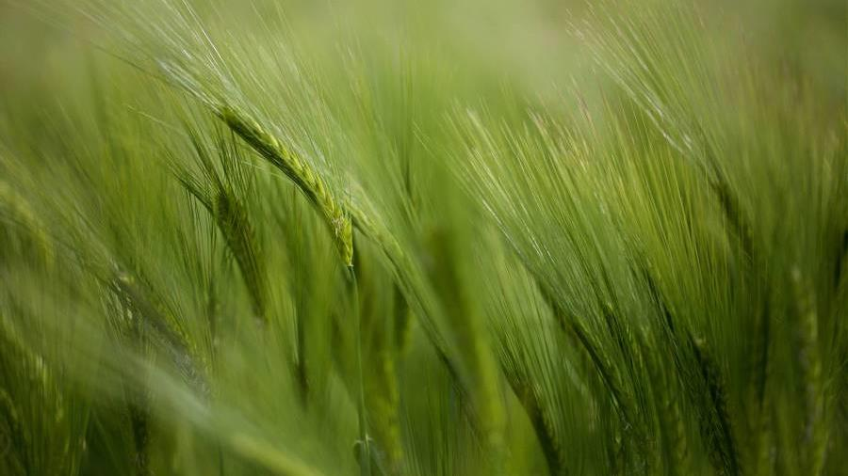
WILDFIRE
Bryan Boyett, Yueqi Peng, Brandon Conover, Abby Harrah

Slide 2
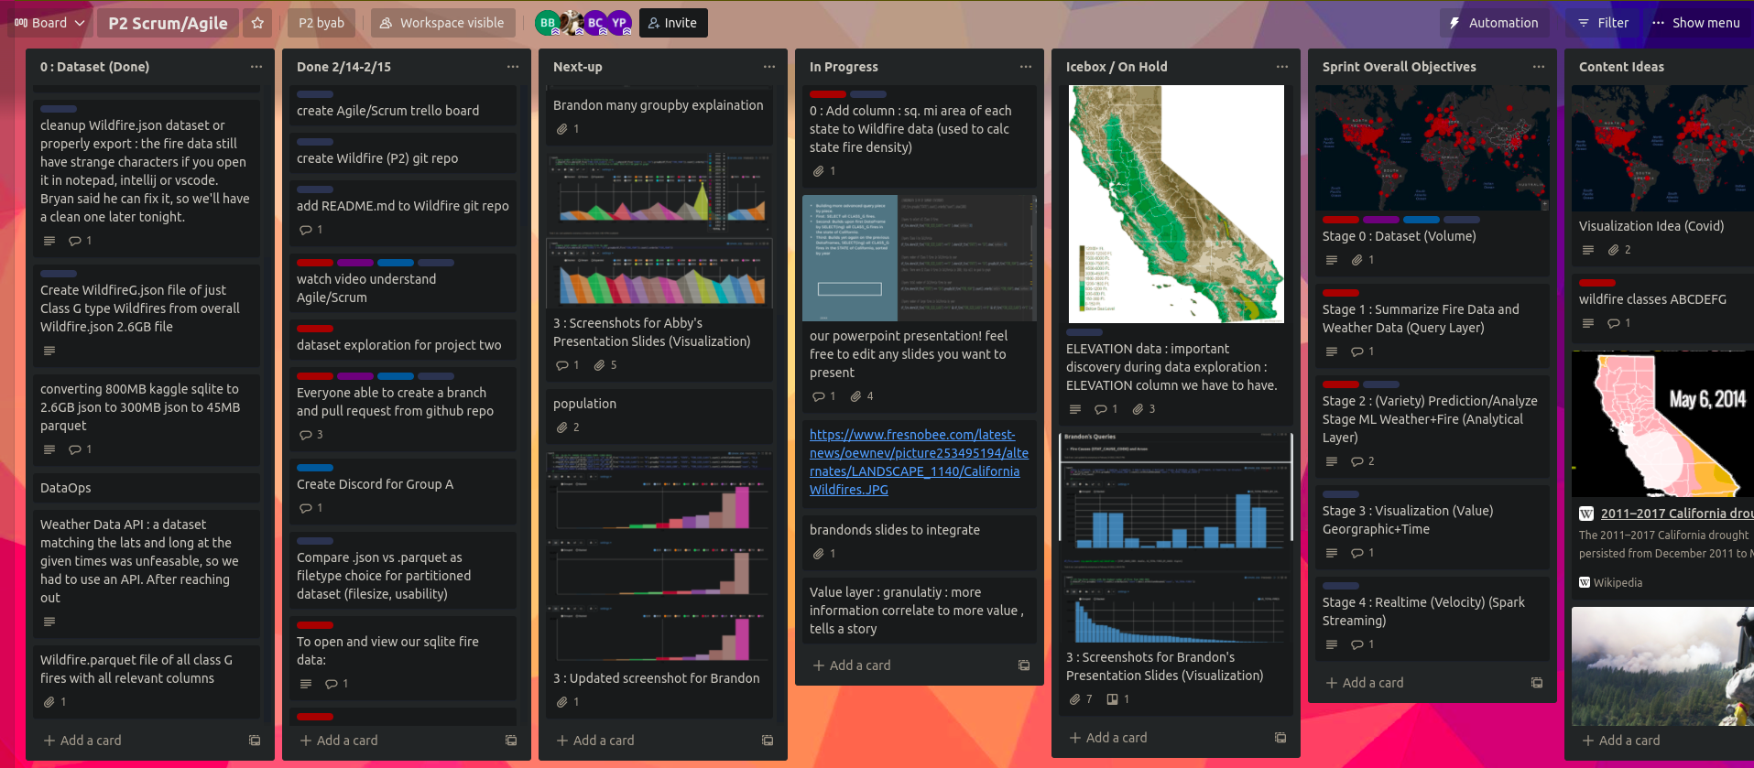
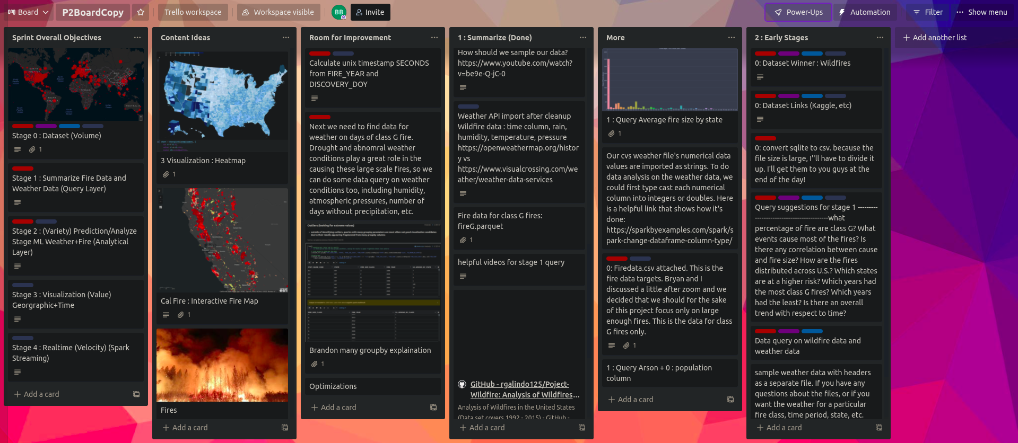




Big data PROJECT OVERVIEW
STAGE 0
STAGE 1
STAGE 2
STAGE 3
STAGE 4
Collecting wildfire data and
Weather API
(Volume)
Demonstrating SparkSQL query results using
Spark SQL
(Value)
Using Spark MLlib for further analysis and ML modeling
(Variety)
Visualizations with Zeppelin and D3
(Variety)
Realtime data with Spark Streaming fed into D3
(Velocity)
2022
wildfire
<number>

Slide 3

Converting file sizes / compression / optimization
800MB kaggle sqlite
- spark cant read sqlite, so export to json
2.6GB json
- able to import into spark
300MB json
- x8.66 reduction by selection : select only needed columns(targets/features)
45MB parquet
- x6.66 reduction by compression : parquet stores as compressed column instead of rows
The 45MB parquet file, WildfireAll.parquet is our final main working Wildfire dataset
The same method will be applied to generate a WeatherAll.parquet file from the Weather API we call via url > save to csv > load into spark and reduction by selection > save as parquet reduction by compression
Stage 0 data
Dataset optimization
Dataset selection
2022
wildfire
2

Slide 4
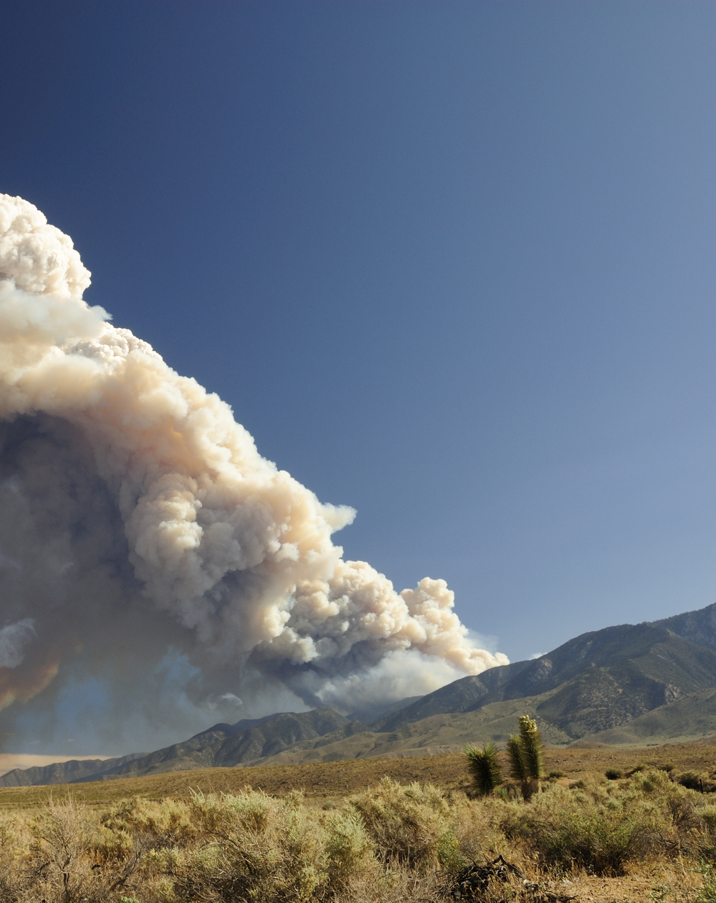
== Attributes we’re looking for == Lat, Lon, Time, Label (output/result)
= Time field = - enable Spark Streaming - Timestamp field - Realtime (V in Velocity)
- Spark Streaming data in to mimic RT = Geographic Coordinates field = - enables strong Visualization layer - Lat column - Lon column - Geographic Visualization plot = Label field = - enables ML and strong Analytical layer - Quantitative Output (y-value, dependent variable) = Features fields = - enables strong Analytical layer - CONNECTED WEATHER DATASET - many columns (x-values, independent variables) = Size = - enables Big Data Volume (100MB+)
What we look for in our data
20XX
Pitch deck
<number>

Slide 5
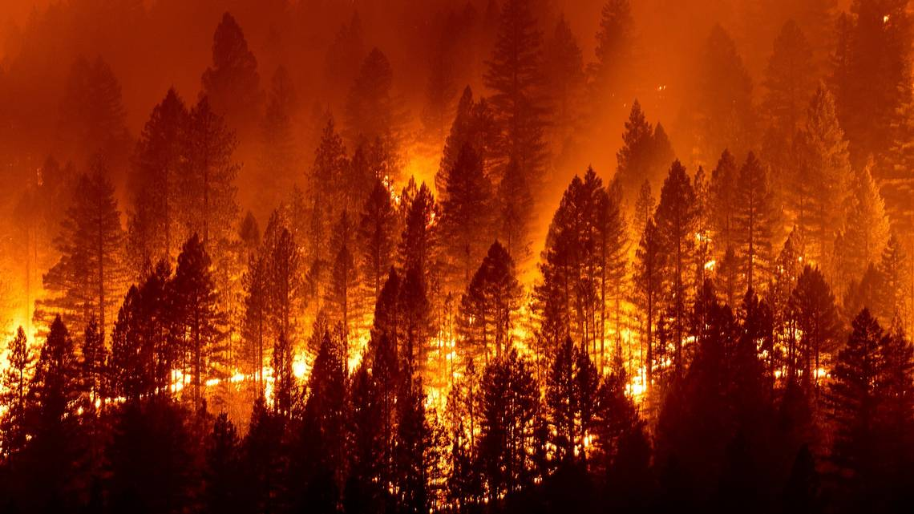
research
Wildfire in US from 1992 to 2015
Weather conditions during times of fire​
Stage 1 query
abstract
Class A - one-fourth acre or less;
Class B - more than one-fourth acre, but less than 10 acres;
Class C - 10 acres or more, but less than 100 acres;
Class D - 100 acres or more, but less than 300 acres;
Class E - 300 acres or more, but less than 1,000 acres;
Class F - 1,000 acres or more, but less than 5,000 acres;
Class G - 5,000 acres or more.
We want to find relationships between the geographic distribution, seasonal change, and cause of wildfires and their sizes, and further correlate the size classes with short-term and long-term weather conditions such as drought
2022
Pitch deck
2

Slide 6
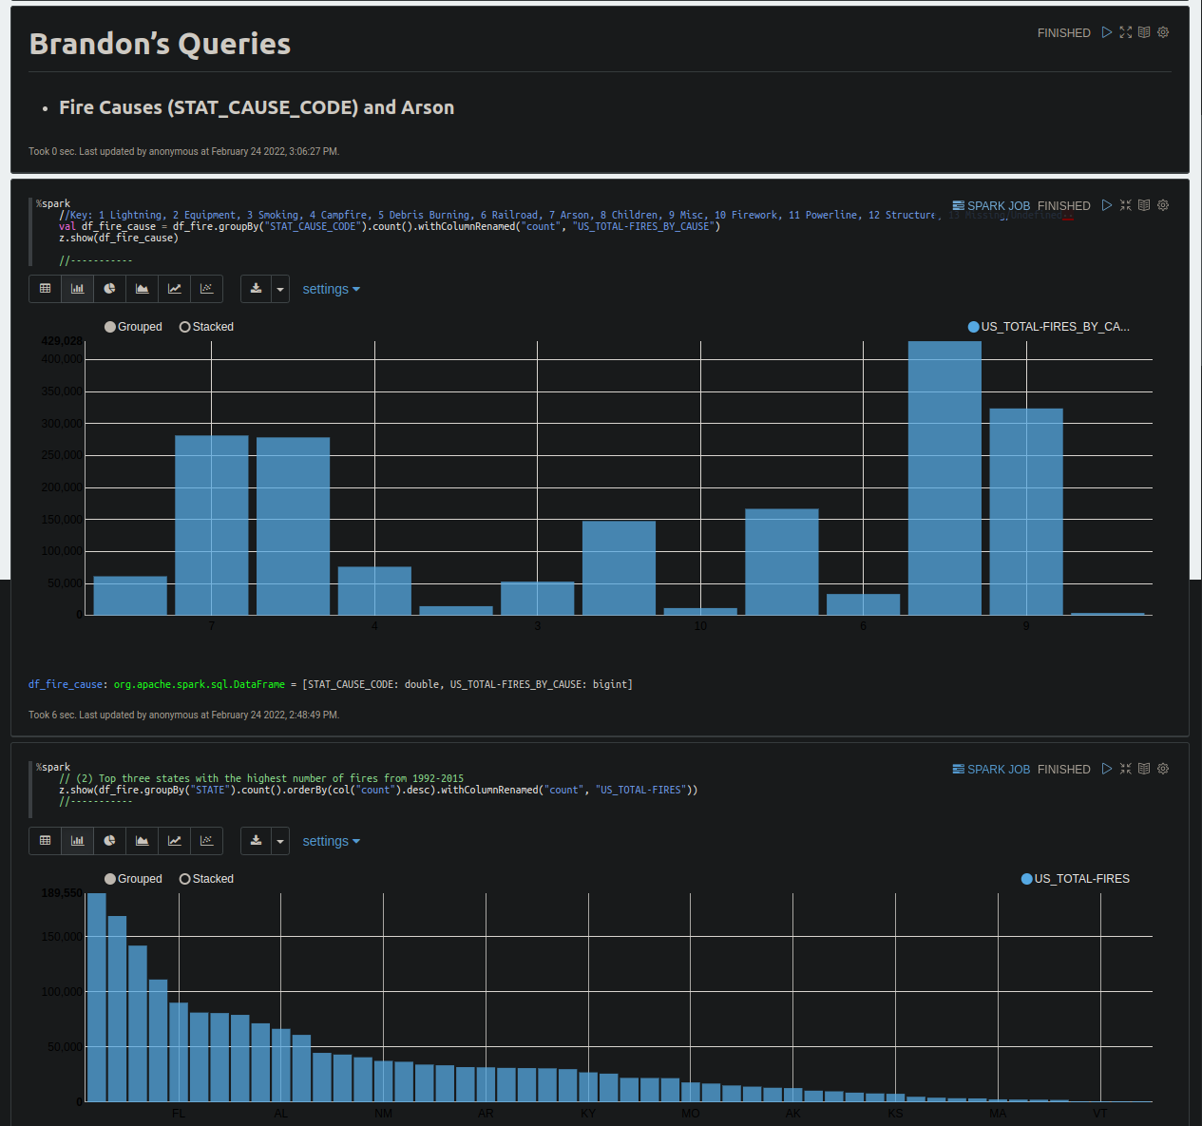
Exploring the Dataset
The original dataset
Purpose
Size
Pairing Down
Initial queries
Top 10 Causes of US Wildfires
Top 3 States with highest number of fires
20XX
<number>

Slide 7
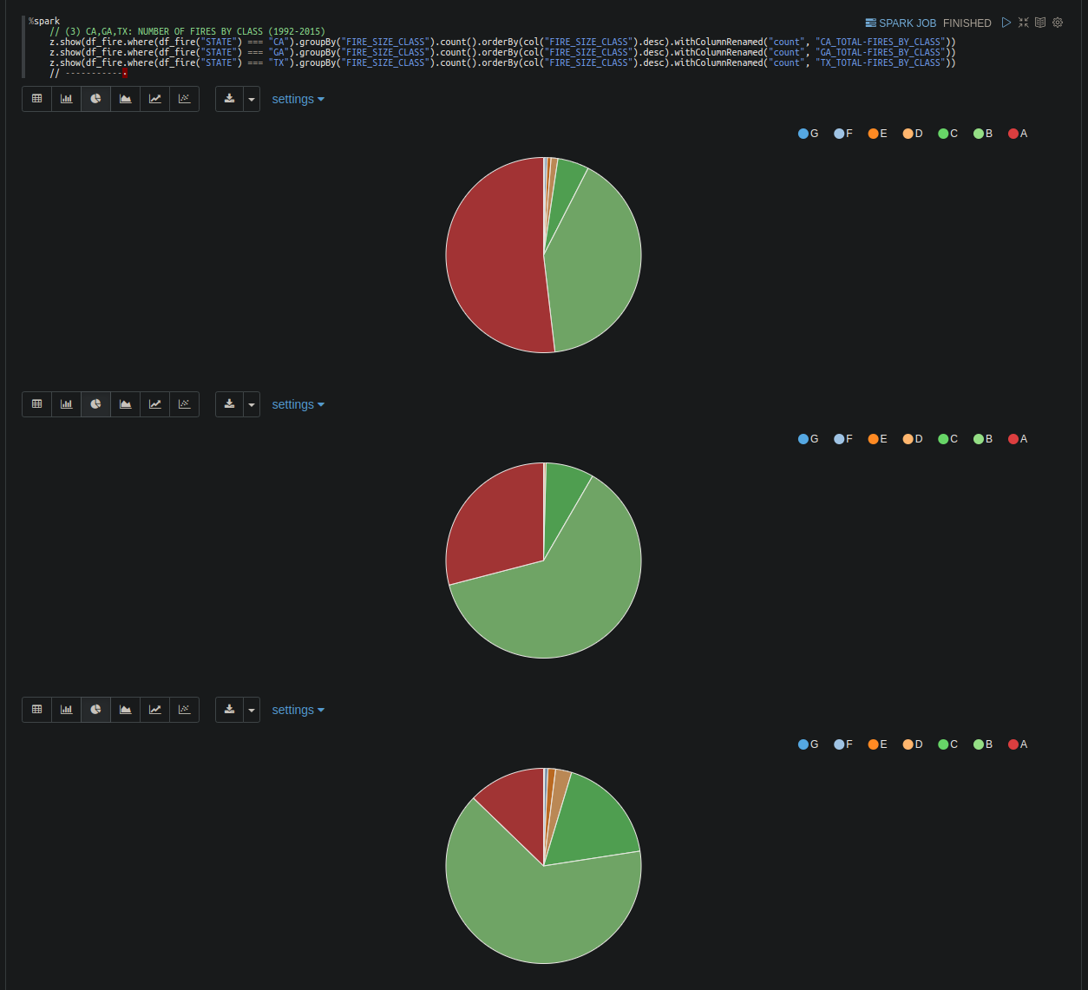
US Fire Class Rankings
------------------------
A - 1/4th acre or less;
B - over 1/4th - 10 acres;
C - 10 - 100 acres;
D - 100 - 300 acres;
E - 300 - 1,000 acres;
F - 1,000 - 5,000 acres;
G - 5,000+ acres
CA / GA / TX
Number of fires by class
B-Class Fires stand out
20XX
<number>

Slide 8
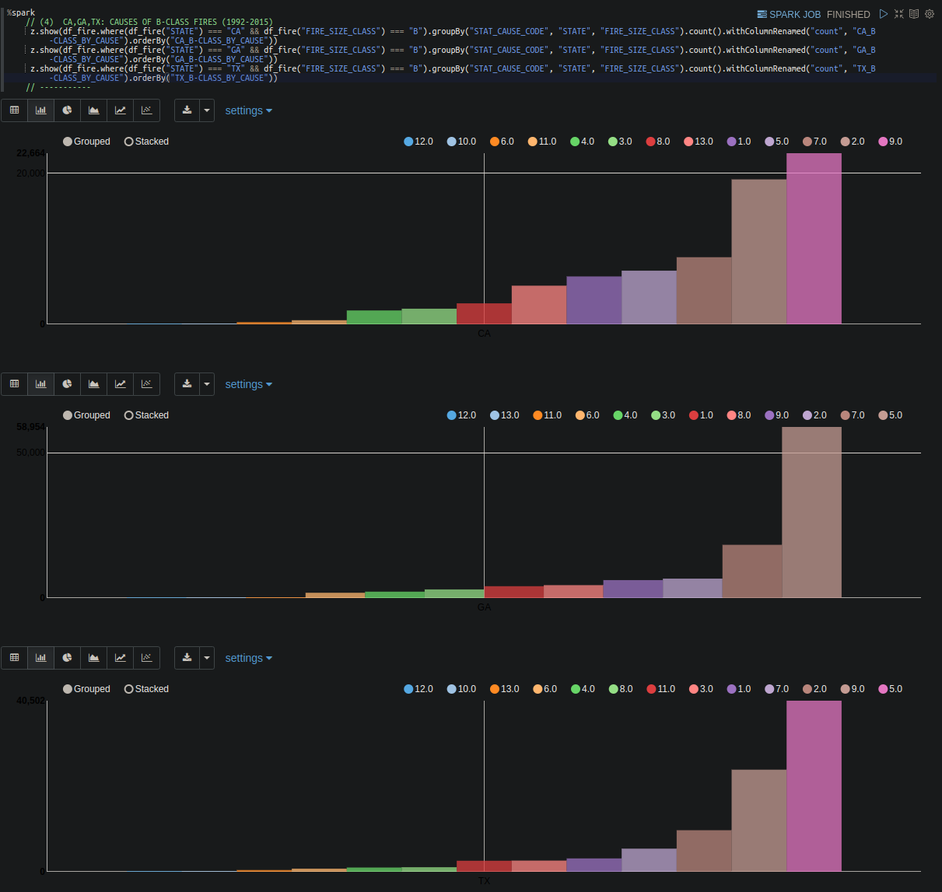
CA/GA/TX
B-Class By Cause
Arson 2nd or 3rd: CA/GA/TX
Highest potential Value
Key:
1 : Lightning
2 : Equipment
3 : Smoking
4 : Campfire
5 : Debris Burning
6 : Railroad
7 : Arson
8 : Children
9 : Misc
10 : Firework
11 : Powerline
12 : Structure
13 : Missing/Undefined
20XX
<number>

Slide 9
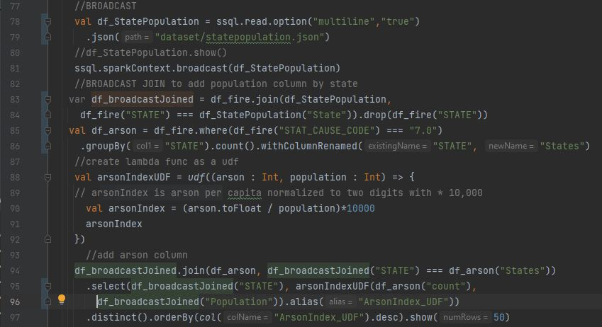
Broadcast small df with .broadcast()
Join small and large df with .join()
Create a UDF function with udf(function())
Use UDF function with columns as arguments
Broadcast Join (Steps 1-2) : reduces costly shuffling operation
UDF Function (Steps 3-4) : creates a new column from a function of existing columns
20XX
<number>

Slide 10
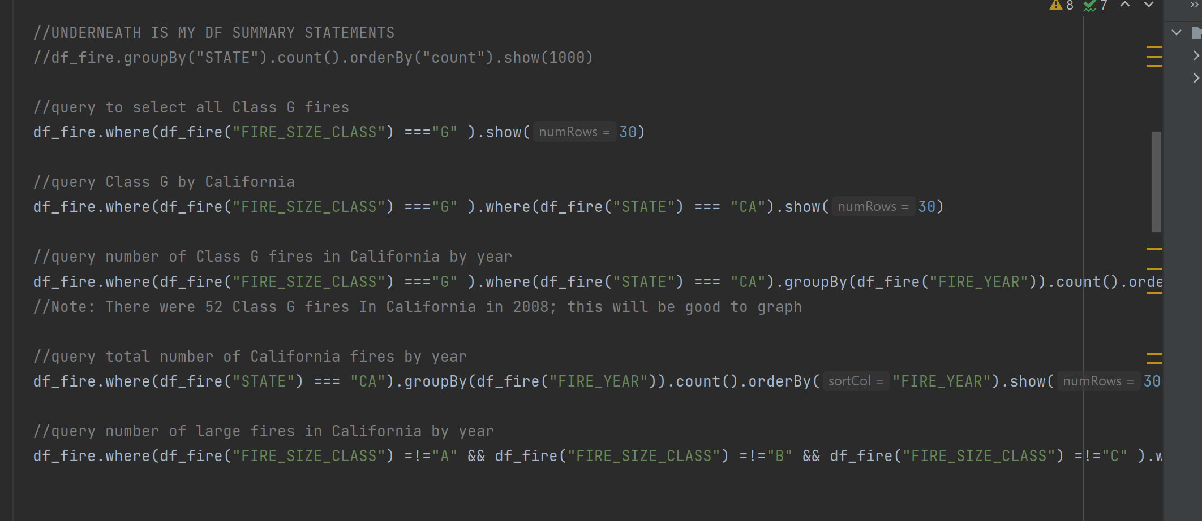
Total Fires in All Classes: G : 3773 F : 7786 E : 14107 D : 28427 C : 220077 B : 939376 A : 666919
Building more advanced query piece by piece.
First: SELECT all CLASS_G fires.
Second: Builds upon first DataFrame by SELECT(ing) all CLASS_G fires in the state of California.
Third: Builds yet again on the previous DataFrames, SELECT(ing) all CLASS_G fires in the STATE of California, sorted by year
Cool and stylish product​
Areas for community connections ​
Online store and market swap
California Queries
Pitch deck
<number>

Slide 11
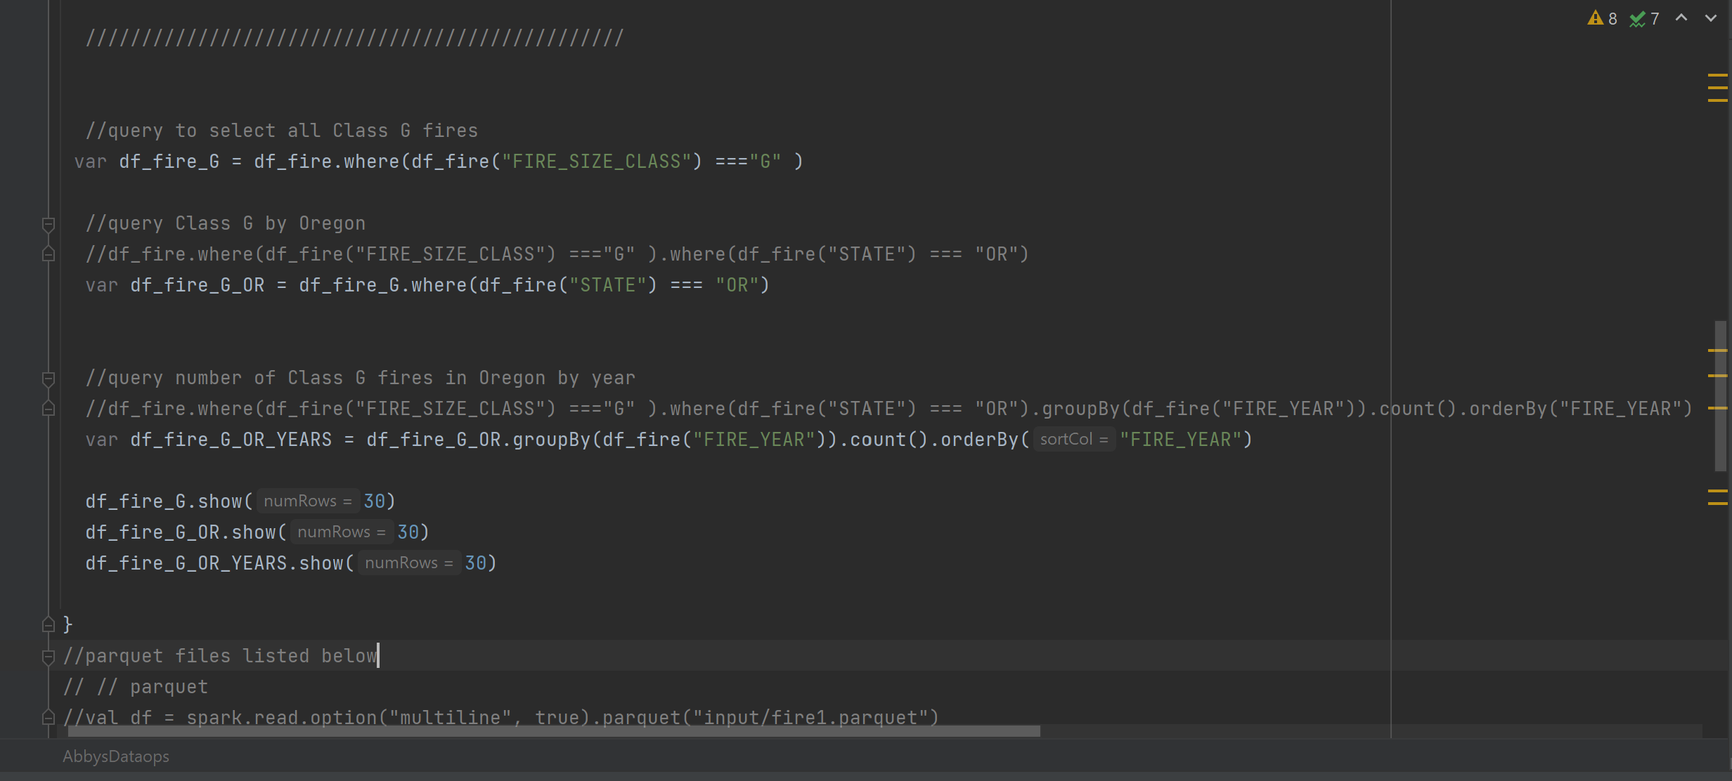
Oregon Queries
Building more advanced query piece by piece.
First: SELECT all CLASS_G fires.
Second: Builds upon first DataFrame by SELECT(ing) all CLASS_G fires in the state of Oregon.
Third: Builds yet again on the previous DataFrames, SELECT(ing) all CLASS_G fires in the STATE of Oregon, sorted by year.
Cool and stylish product​
Areas for community connections ​
Online store and market swap
20XX
Pitch deck
<number>

Slide 12
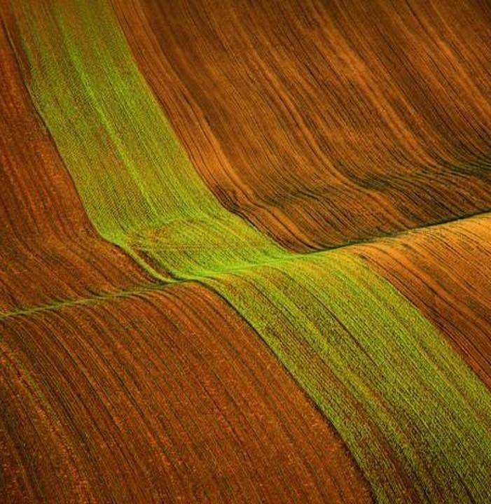
Stage 2 ML
Chi Square Test
Correlation Matrix
Logistic Regression Model
2022
wildfire
2

Slide 13
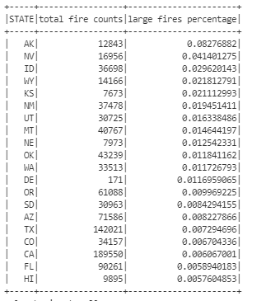
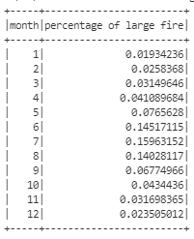
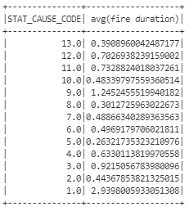

Are fire sizes and states, fire causes, or seasons related?
Hypothesis testing
P-value<0.05
2022
wildfire
2

Slide 14
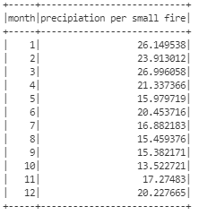
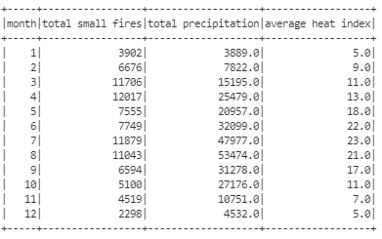
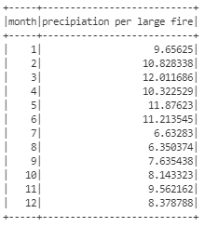
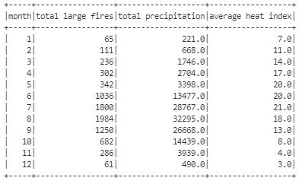
Are fire size related to current weather or past weather conditions?
Based off weather data from 14 days prior to the start of fire
Based off weather data since the discovery date of fire
2022
wildfire
2

Slide 15
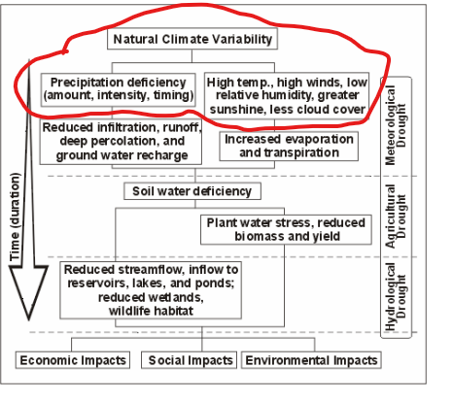
Possibility of drought influencing fire size
long-term vs short-term
2022
wildfire
2

Slide 16
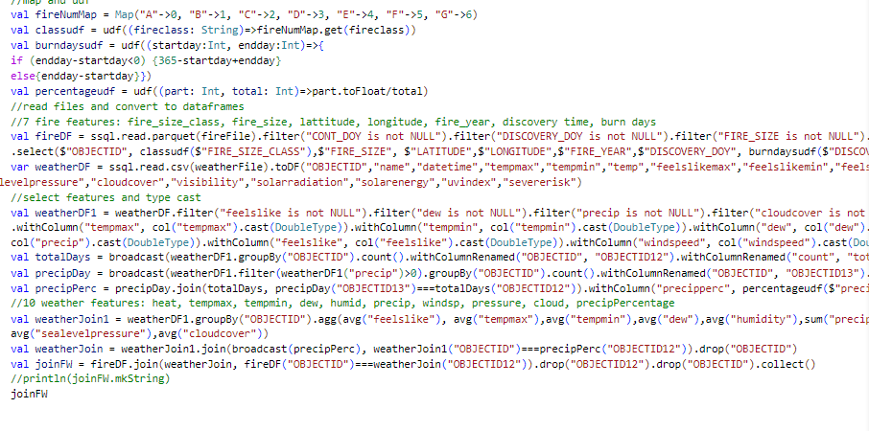
Correlation matrix
Pearson
14 day prior weather conditions
Get volunteers​
Gather feedback​
Deliver to consumers​
Jan
Feb
Mar
Apr
May
Jun
Jul
Aug
Sep
Oct
Nov
Dec
Run focus groups​
Test with farms​
Regional launch​
Jan
Feb
Mar
Apr
May
Jun
Jul
Aug
Sep
Oct
Nov
Dec
2022
wildfire
2

Slide 17
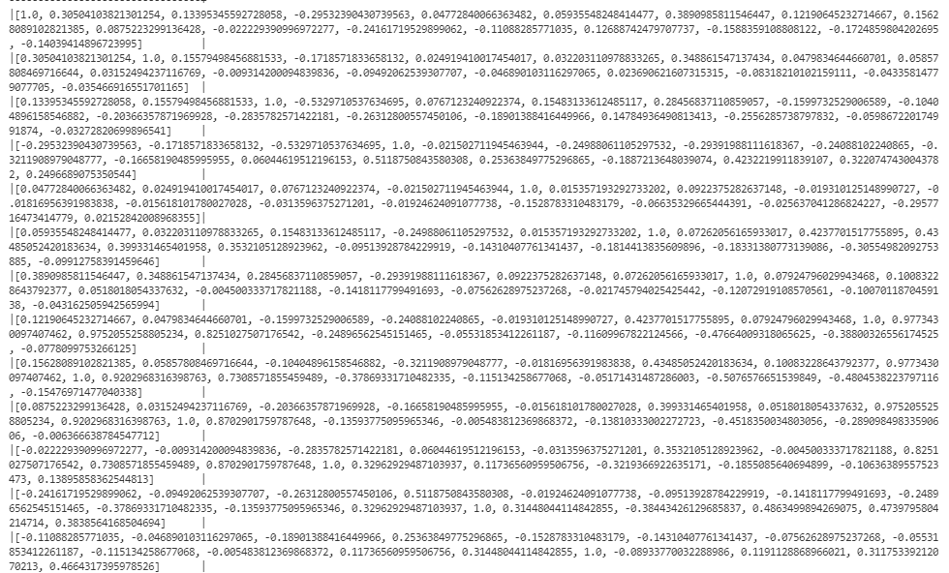
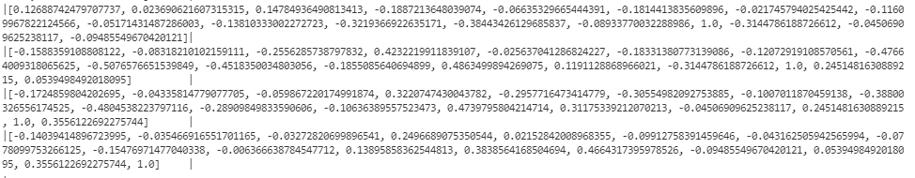
7 fire features: fire_size_class, fire_size, lattitude, longitude, fire_year, discovery time, burn days
10 weather features: heat, tempmax, tempmin, dew, humid, precip, windsp, pressure, cloud, precipPercentage
Validation: 0.97734/0.9752/0.8251: heat, tempmax, tempmin
20XX
Pitch deck
<number>

Slide 18
Logistic regression model
10 weather features: heat, tempmax, tempmin, dew, humid, precip, windsp, pressure, cloud, precipPercentage
Since our data is so big, we didn’t use all our records. Splitting the data into 80% training and 20% testing is generally an accepted practice in data science.
Entire data
Over 26 million rows without sampling, or around 18 GB JSON
2022
wildfire
2

Slide 19

Data analysis summary
“How you can use stage 1 queries trends to make some useful decisions" : Insurance (Fire and Property Insurance); Firefighters ($100+ million class G fires)
“How we can be prepared for the next big fire with stage 2 ML model”: watch for extreme weather conditions, they’re indicators; what about elevation? Climate change?
“What more we could do given our stage 3 visualization”: apply ML model to current weather conditions to predict and prevent future damages; visualize on heat map future predictions
20XX
Pitch deck
<number>

Slide 20
Large Volume Dataset Optimizations
Github & Software DEV
Wildefire dataset : SQLite -> Json -> parquet
Weather dataset : Online API -> csv ->parquet
- Pair programming,
- Individual branches instead of feature branches enabled easier merges
Technologies, Optimizations, Difficulties,
Zeppelin
UDF (Normalization)
switched to Linux system to build Zeppelin from source as current build required specific versioning
- UDFs are useful for normalizing column data
- Brandon’s Arson UDF normalizing arson per population
- Yueqi’s multiple UDFs normalized columnar data for her ML models
cross-build
Crossbuild enabled sharing objects and data between Scala JVM and Scala.js (node) compilers
2022
wildfire
2

Slide 21

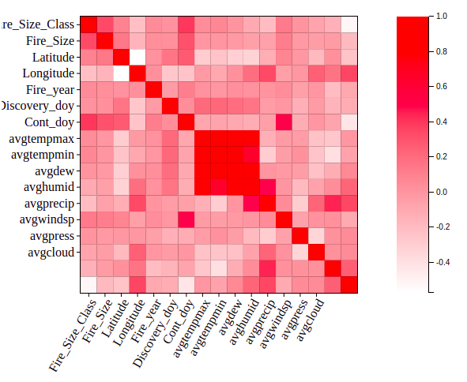
Stage 3 visualization
Zeppelin
Quickly generate visualizations for queries with simple z.show()
D3
Prebaked templates, also enables realtime visualizations if you implement Spark Streaming
Heat map
Distribution of class G fires across United States
2022
wildfire
2

Slide 22
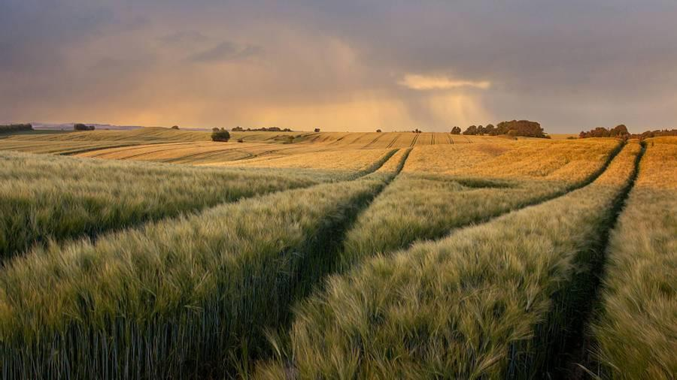
Thank you

